Slide 1


Empower Your Skills, Boost Your Productivity for a Prosperous Pakistan
Pak Angels Essential Generative AI Training Cohort-II
THE RISE OF
GENERATIVE AI
A GAME - CHANGER

Slide 2
Empower Your Skills, Boost Your Productivity for a Prosperous Pakistan
Pak Angels
Essential Generative AI Training
Module
Hands-on with Generative AI Models

Slide 3

Empower Your Skills, Boost Your Productivity for a Prosperous Pakistan
Hugging Face
The AI Powerhouse
Hugging Face is known for its NLP models and tools
Hugging Face – The AI community building the future.

Slide 4




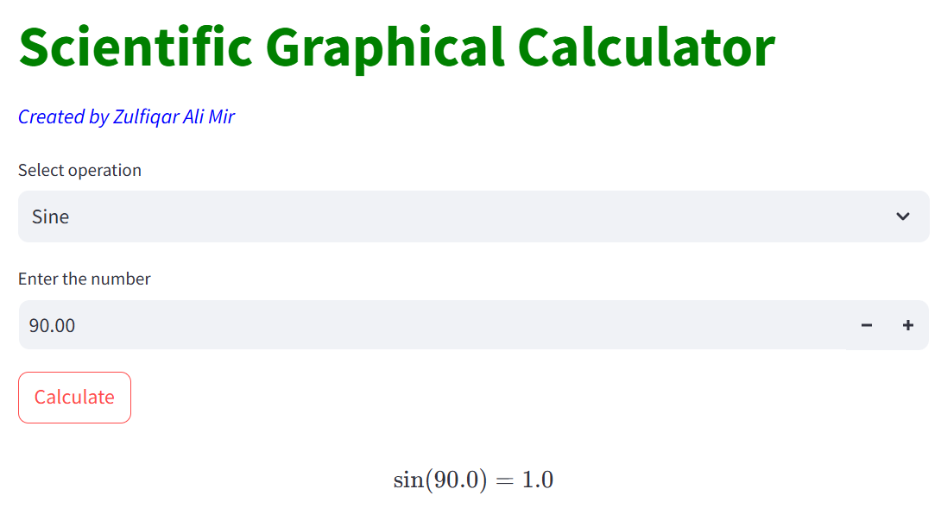
Pak Angels Essential Generative AI Training Cohort-II
The AI Powerhouse

Slide 5
Empower Your Skills, Boost Your Productivity for a Prosperous Pakistan
Introduction to
Hugging Face
What is Hugging Face? Hugging Face is a leading company in Artificial Intelligence, primarily focused on Natural Language Processing (NLP). It has democratized AI by providing access to pre-trained models and tools that make building AI-powered applications much easier.
Key Offering: Hugging Face’s open-source libraries are widely adopted by both researchers and developers to enhance productivity in AI tasks like language modeling, machine translation, and text generation.
Hugging Face – The AI community building the future.

Slide 6
Empower Your Skills, Boost Your Productivity for a Prosperous Pakistan
Core Products
Transformers Library: A rich library providing pre-trained models for NLP tasks. Some popular models include:
BERT (Bidirectional Encoder Representations from Transformers): Great for text classification.
GPT (Generative Pre-trained Transformer): Used for text generation.
T5 (Text-To-Text Transfer Transformer): A unified framework for NLP tasks.
Hugging Face – The AI community building the future.

Slide 7




Empower Your Skills, Boost Your Productivity for a Prosperous Pakistan
Open-Source Models
Hugging Face and Langchain.ipynb - Colab (google.com)

Slide 8
Empower Your Skills, Boost Your Productivity for a Prosperous Pakistan
Core Products
Datasets Library: An extensive collection of datasets for NLP and computer vision.
You can use this to quickly access the data needed for model training or fine-tuning.
Hugging Face – The AI community building the future.

Slide 9
Empower Your Skills, Boost Your Productivity for a Prosperous Pakistan
Core Products
Model Hub: Hugging Face’s Model Hub offers thousands of pre-trained models shared by the community and organizations, ready for use.
Hugging Face – The AI community building the future.

Slide 10
Empower Your Skills, Boost Your Productivity for a Prosperous Pakistan
Why Hugging Face Matters?
Ease of Use: Hugging Face has made state-of-the-art NLP models accessible with just a few lines of code.
Pre-trained Models: No need to start from scratch. Pre-trained models can be fine-tuned to solve specific tasks in domains like healthcare, finance, customer service, and more.
Community Focus: Hugging Face fosters a massive, collaborative open-source community.

Slide 11
Empower Your Skills, Boost Your Productivity for a Prosperous Pakistan
Popular Use Cases
Text Classification: Spam detection, sentiment analysis, topic categorization.
Hugging Face models can be used to label texts in real-time.
Question Answering: Hugging Face’s models power systems that answer user questions based on input documents.
A common use case is FAQ chatbots.
Text Generation: Generating human-like text for chatbots, creative writing, code generation, etc.

Slide 12
Empower Your Skills, Boost Your Productivity for a Prosperous Pakistan
Hands-on Demo
from transformers import pipeline
# Load a pre-trained model for sentiment analysis
classifier = pipeline("sentiment-analysis")
# Test on a sample text
result = classifier("Hugging Face is amazing!")
print(result)
This code loads a pre-trained sentiment analysis model and analyzes the sentiment of a given text.
Hugging Face makes it this simple to use cutting-edge models.
Hugging Face Demo.ipynb - Colab (google.com)

Slide 13

Empower Your Skills, Boost Your Productivity for a Prosperous Pakistan
Hands-on Demo
This code loads a pre-trained sentiment analysis model and analyzes the sentiment of a given text.
Hugging Face makes it this simple to use cutting-edge models.
Hugging Face Demo.ipynb - Colab (google.com)

Slide 14
Empower Your Skills, Boost Your Productivity for a Prosperous Pakistan
Hands-on Demo
mrm8488/distilroberta-finetuned-financial-news-sentiment-analysis · Hugging Face
Hugging Face Demo.ipynb - Colab (google.com)

Slide 15
Empower Your Skills, Boost Your Productivity for a Prosperous Pakistan
Hands-on Demo
What is this token?
API Token:
It is an access key that allows you or applications to interact with Hugging Face resources (datasets, models, spaces, etc.) and the inference API for tasks like deploying models or making predictions.
Hugging Face Demo.ipynb - Colab (google.com)

Slide 16
Empower Your Skills, Boost Your Productivity for a Prosperous Pakistan
Hugging Face Hub and Spaces
Model Hub:
The go-to place to find, share, and use pre-trained models. You can search for models based on specific tasks like text generation, translation, and more.
Hugging Face Spaces:
A platform to build and share AI apps powered by models on the Hugging Face Hub. Hugging Face supports integration with tools like Gradio and Streamlit for app development.

Slide 17
Empower Your Skills, Boost Your Productivity for a Prosperous Pakistan
Community and Collaborations
Open-Source Spirit:
Hugging Face is a pioneer in building a collaborative AI ecosystem.
Researchers, developers, and organizations alike contribute models and datasets to the platform.
Partnerships:
Hugging Face works with tech giants like Microsoft and Google to push the boundaries of AI.
They also integrate their models with major cloud services.

Slide 18
Empower Your Skills, Boost Your Productivity for a Prosperous Pakistan
Conclusion
Hugging Face’s Impact:
Hugging Face is driving the AI revolution by enabling rapid development of NLP solutions.
Call to Action:
I encourage you all to explore Hugging Face, experiment with the models, and see how AI can benefit your own projects and industries!

Slide 19

Empower Your Skills, Boost Your Productivity for a Prosperous Pakistan
Regards,
Zulfiqar Ali Mir
LinkedIn: https://www.linkedin.com/in/zulfiqar-ali-mir/

Slide 20

Empower Your Skills, Boost Your Productivity for a Prosperous Pakistan
Regards,
Zulfiqar Ali Mir
LinkedIn: https://www.linkedin.com/in/zulfiqar-ali-mir/

